Slide 1


Hope to Skills
Lecture# 20
Irfan Malik, Dr. Sheraz Naseer

Slide 2
Agenda
Model Evaluation
Evaluation Metrics
Accuracy
Precision
Recall

Slide 3
Previous lecture:
Lecture 19 - Regression
Click Here

Slide 4
Why Evaluate Machine Learning Models?
Improved decision-making: Evaluation shows how well a model works, guiding choices about deployment and improvement.
Overfitting Prevention: Evaluation can warn against models that might memorize training data but do poorly on new data.
Fine-tuning: Assessment enables us to tweak the model improving its effectiveness.
Fair Comparison: It enables us to objectively compare different models.

Slide 5
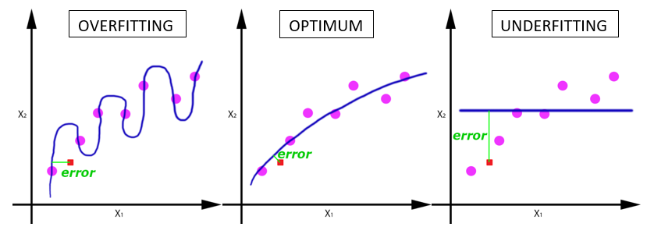
What is Underfitting?
Too Simple: An underfit model fails to capture the underlying pattern of the data.
Poor Performance: This leads to errors on both the training set and unseen data.
Example: Trying to fit a straight line to data that has a clear curve.

Slide 6
What is Overfitting?
Too Complex: An overfit model learns the training data too well.
Memorization, not Generalization: It becomes a lookup table rather than a pattern detector.
Poor performance on new data: The model becomes overly specific to the training data and makes bad predictions on unseen examples.

Slide 7
Consequences of Overfitting and Underfitting
Inaccuracy: Both lead to unreliable predictions.
Underfitting: High bias, the model consistently gets it wrong in a certain way.
Overfitting: High variance performance wildly depends on the specific data it has seen.

Slide 8
Consequences of Overfitting and Underfitting

Slide 9
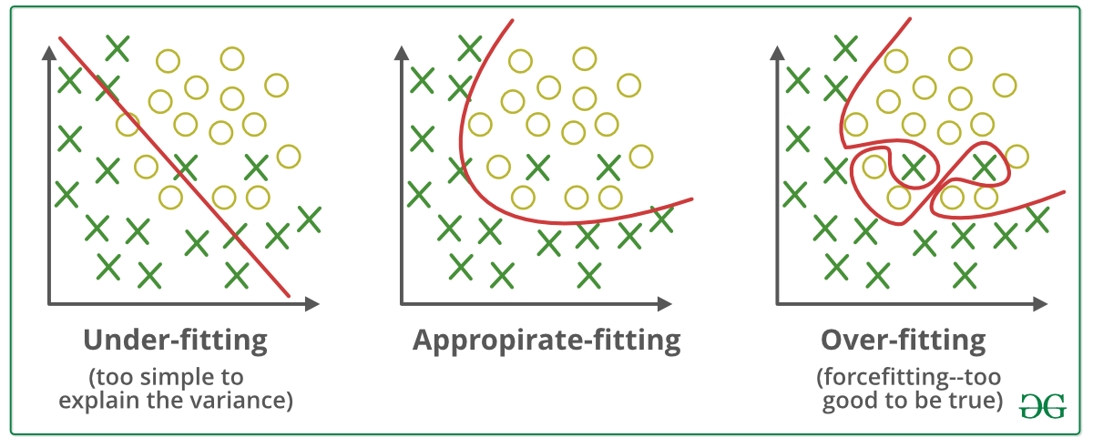
Our Goal

Slide 10
Basics - Training, Validation, and Testing Data
Training Data: We feed this data into a machine learning algorithm to develop a model.
Validation Data: This dataset tunes model parameters (hyperparameters), helping prevent overfitting.
Testing Data: Provides a final, unbiased picture of how well the model performs on unseen data.

Slide 11
Key Evaluation Metrics (Classification)
Accuracy
Precision
Recall
F1-Score

Slide 12
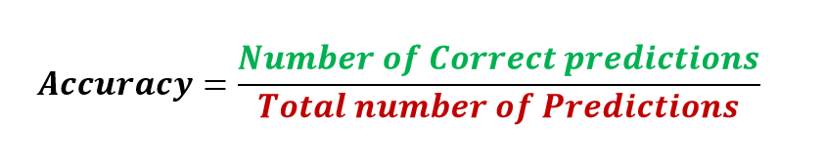
Accuracy
It is the ratio of number of correct predictions to the total number of input samples.
Note:It works well only if there are equal number of samples belonging to each class.

Slide 13
Accuracy- Example
Consider that there are 98% samples of class A and 2% samples of class B in our training set. Then our model can easily get 98% training accuracy by simply predicting every training sample belonging to class A.
When the same model is tested on a test set with 60% samples of class A and 40% samples of class B, then the test accuracy would drop down to 60%.
Classification Accuracy is great, but gives us the false sense of achieving high accuracy.
The real problem arises, when the cost of misclassification of the minor class samples are very high.

Slide 14
Possible Scenarios
True Positives (TP): Things your model predicted positive that were genuinely positive.
False Positives (FP): Things your model predicted as positive, but that were actually negative.
True Negatives (TN): Things correctly predicted as negative.
False Negatives (FN): Things incorrectly predicted as negative, when they were positive.

Slide 15
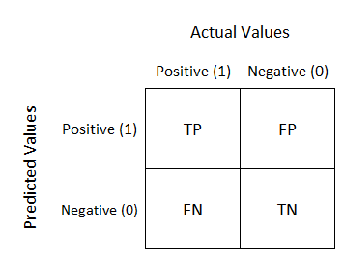
Confusion Matrix
Confusion Matrix as the name suggests gives us a matrix as output and describes the complete performance of the model.

Slide 16
Confusion Matrix
True Positives : The cases in which we predicted YES and the actual output was also YES.
True Negatives : The cases in which we predicted NO and the actual output was NO.
False Positives : The cases in which we predicted YES and the actual output was NO.
False Negatives : The cases in which we predicted NO and the actual output was YES.

Slide 17
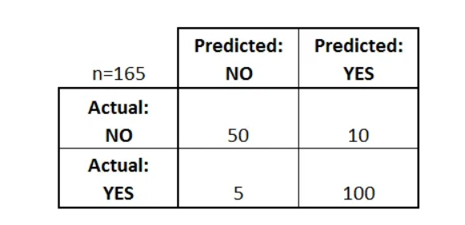
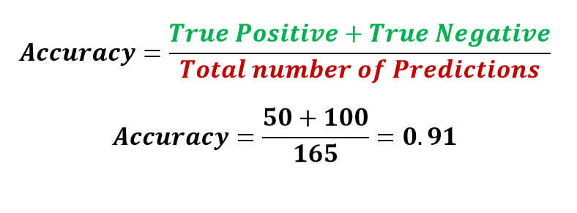
Confusion Matrix - Accuracy
Note: Only reliable when we have balanced classes

Slide 18
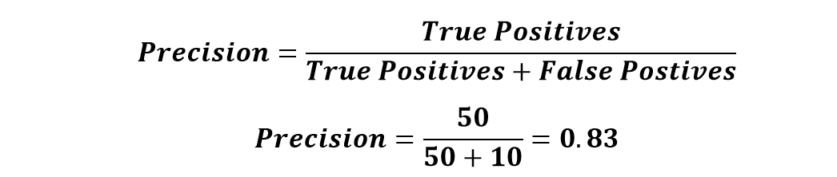
Confusion Matrix - Precision
It is the number of correct positive results divided by the number of positive results predicted by the classifier.
precision emphasizes minimizing false positives.
Use case example: Medical tests, where false positives (Predicted Diseased but actually healthy) can lead to unnecessary treatments.

Slide 19
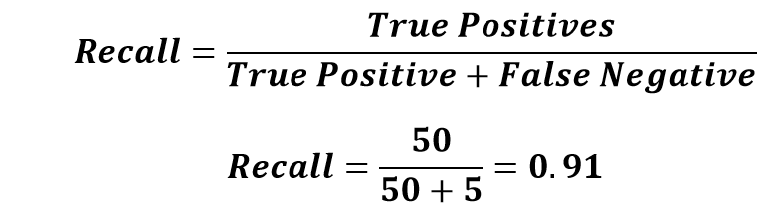
Confusion Matrix - Recall
The ratio of correctly predicted positive instances to the total actual positive instances.
Recall focuses on minimizing false negatives.
Use case example: Disease detection, where False Negative (predicted healthy but actually diseased) can have serious consequences.

Slide 20
Example
A veterinarian builds a machine learning model to detect whether cats have a specific feline disease based on medical test results.
Data:
The vet collected data on 100 cats. Here's a breakdown:
Actually Have the Disease: 40 cats
Actually Healthy: 60 cats
Model Predicted Positive (Disease): 45 cats
Model Predicted Negative (Healthy): 55 cats

Slide 21
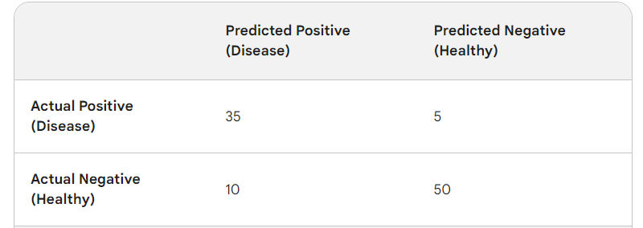
Example

Slide 22
Calculate Precision - Example
Calculate Precision
Precision = TP / (TP + FP)
Precision = 35 / (35 + 10) = 35/45 = 0.78 (or 78%)
Interpretation: When the model predicts a cat has the disease, it's correct 78% of the time. That means there's a 22% chance of overdiagnosis.

Slide 23
Calculate Recall - Example
Recall = TP / (TP + FN)
Recall = 35 / (35 + 5) = 35/40 = 0.875 (or 87.5%)
Interpretation: For cats that actually have the disease, the model correctly identifies them 87.5% of the time. The remaining 12.5% risk being missed by the model.

Slide 24
Confusion Matrix - Example
Suppose you trained a model to classify cancer patients. You want evaluate the model performance. You have to answer the following questions Accuracy? Precision? and Recall?
What should be of more concerned Accuracy. Precision. Recall?
 | Predicted Cancer = Yes | Predicted Cancer = No
Actual Cancer = Yes | 96 | 11
Actual Cancer = No | 17 | 54

Slide 25
Real-World Examples
Fraud detection:
High precision to avoid false positives (Predicted Fraud actually not-Fraud)
Medical diagnoses:
High recall to minimize false negatives (Predicted healthy but actually diseased).

Slide 26
Key takeaways
Accuracy (total % of correct classifications) is often not a meaningful performance metric when data sets are imbalanced
Class imbalance implies that one class is represented much more often than others. Penalizing certain misclassifications and re-sampling the data set help dealing with imbalances.
Precision is a metric that penalizes false positives. As such, models with high precision are cautious to label an element as positive.
Recall is a metric that penalizes false negatives. Models with high recall tend towards positive classification when in doubt.

Slide 27
Next Lecture:
Lecture 21 - Evaluation Metrics II
Click Here

